Slide 1

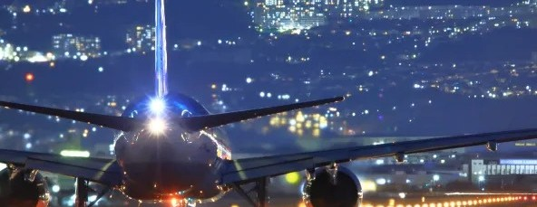
AVIATION INDUSTRY
PRESENTED BY-
ISHA MANDLOI SHANKH BANSALI

Slide 2

Learning Objective-
To gain knowledge about various industies.
How micro and macro factors affect the overall industrial environment.
To understand the term micro and macro factors.

Slide 3

Indian Aviation Industry is considered as one of the fastest growing Aviation Industry in the world.
India is currently the 7th largest aviation market in the world.
It is expected to overtake China and United States to become the 3rd largest air passenger market in the next ten year. 4.The rising demand in the sector has pushed the no. of airplanes operating in the sector.

Slide 4
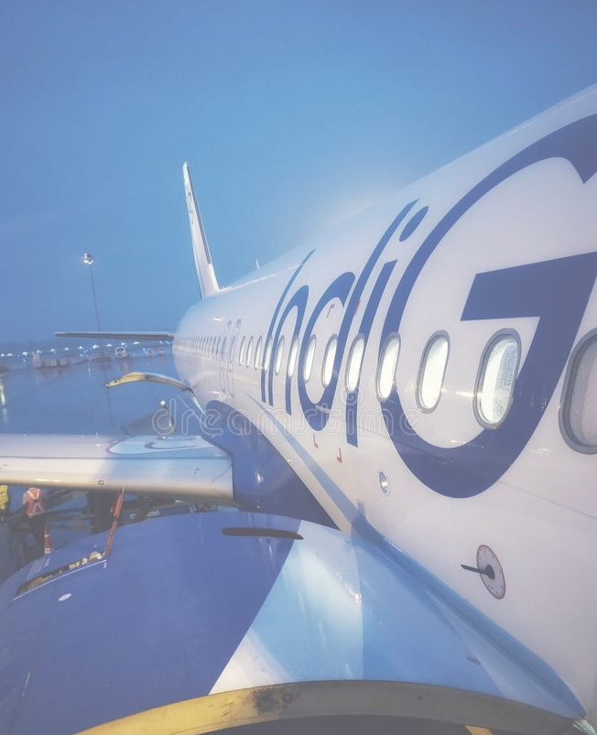
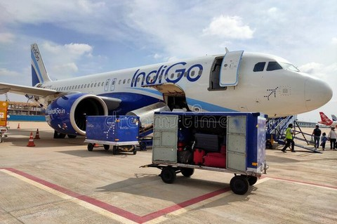
IndiGo
Indigo is largest airline company in India with the highest market share.
It is the private,low cost carrier based in Gurgaon,Haryana,India.
India's largest passenger airline with market share of 56.6%..
Ranked as the 4th most panctual airline globally. 5.Best low cost airline in India.
Interglobe Aviation Ltd.(IndiGo)

Slide 5
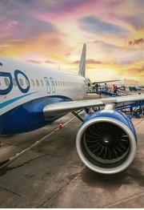
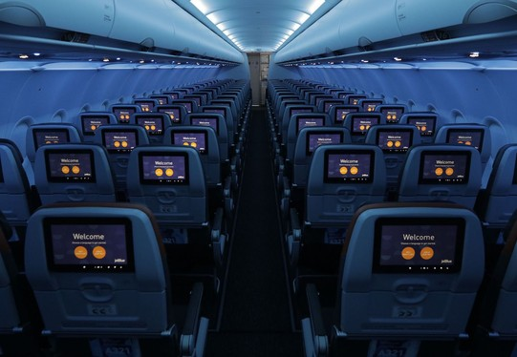
Why is the market leader?
Indigo's stuck to it's low cost.
Single class model unlike rivals to Jet Airways.
Quality and detail key to good service.
It's all about customer focus.
Using technology smartly.

Slide 6
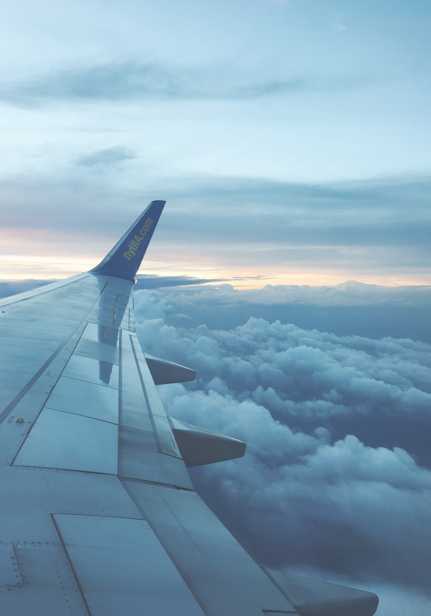
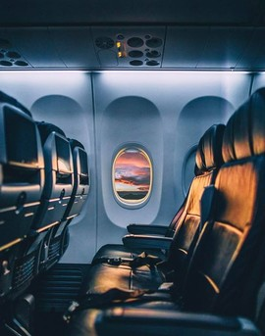
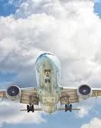
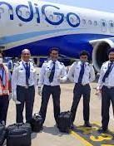
Macro environment factors
that impact the overall business environment.
Political
Economic
Social
Technological
Environmental
Legal

Slide 7

POLITICAL
FACTORS
Stability
Currently, the geographic area in which IndiGo Airlines is actively
present is experimencing some political instability due to internal and external conflicts.
Transparency
Airline is facing several issues due to corruption and lack of
transperancy.
Governance System
IndiGo Airlines acan benefit from the economic freedom offered by the democratic governance system, which promotes entrepreneurship and free trade.

Slide 8

Economical
Factors
Inflation
The rising inflation rate can have a negative impact on the revenue growth of IndiGo
Airlines as its decreases the purchasing power of money and discourages consumer spending on goods and services.
Exchange and interest rate
Fluctuations in the exchange rate can affect Indigo's business profitability.
They should study the exchange rate fluctuations to make accurate anticipations so
that the undesired trade and business performance consequences could be avoided.
Demand of labour and supply
The timely availability of skilled workers is crucial for IndiGo Airlines to stay ahead of
the competition as its performance heavily depends on the skills and competencies of its workforce.

Slide 9
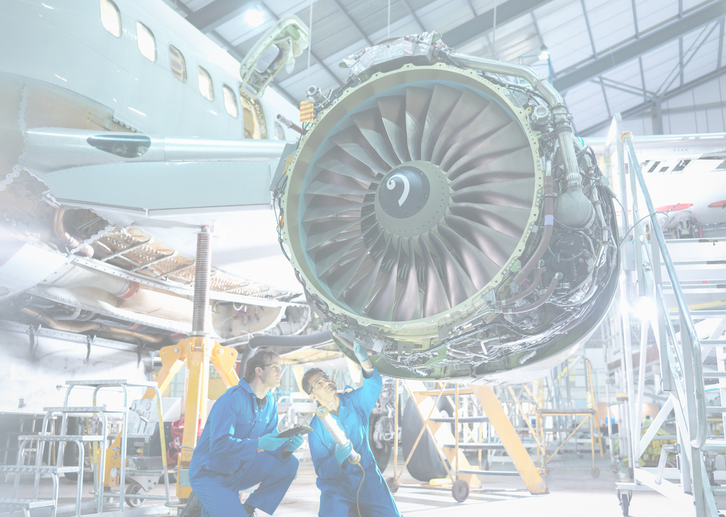
Social
Factors
Consumption behaviour
When consumers have more disposable income and are willing to spend more on goods and services to improve their lifestyle, it provides exciting growth opportunities to IndiGo Airlines , as introducing new products and services to these customers is easier, and revenue growth chances also remain higher.
Demographics
High population growth and rising proportion of young population segment are two favourable demographic indicators for IndiGo Airlines .
Social equality
Social class stratification and respect for hierarchy are some important social factors that can influence the business, marketing, and human resource management strategies of IndiGo Airlines.

Slide 10

Technological
Factors
E-Commerce & Related Infrastructure Development
As E-Commerce is critical for Indigo Aviation business model. It should evaluate the e-
commerce infrastructure, technology infrastructure etc before entering a new market.
Likelihood of Technology Disruption
If the country is hub of technology companies then there is a high chance of
technology disruption among various industries. Indigo Aviation has to assess whether it can live with the fast pace of technology disruption in its industry.
Internet penetration
The higher internet penetration has helped IndiGo Airlines in improving its quality and delivery, as well as allowed it to engage in strategic communications and marketing processes.

Slide 11
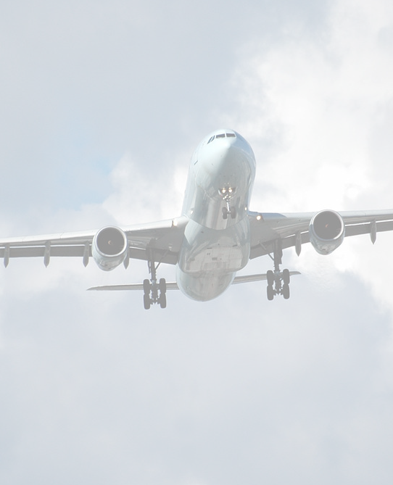
Environmental
Factors
Environmental Regulations
Stringent environmental regulations in many countries are pressurizing business organizations to reduce environmental harm. In response, IndiGo Airlines should adopt responsible production practices, encourage responsible consumption practices among its targeted consumers, try to improve it.
Climate change
Climate change will impact Indigo Aviation business model and supply chain. For example if the supply chain is not flexible it can lead to bottlenecks if shipments from one part of the world are delayed because of sudden climate shift.

Slide 12
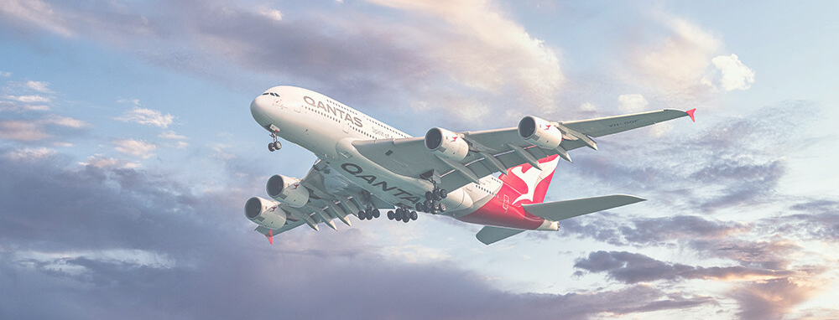
Environmental Standards
Often the environment policy at national and local level can be different. This can help Indigo Aviation in numerous decisions such as plant location, product development, and pricing strategy.

Slide 13

Legal
Factors
Intellectual property rights
Strict compliance with the intellectual property laws makes the business environment safer for firms like IndiGo Airlines , as their patents are protected from imitation, leading towards sustainable competitive advantage.
Consumer protection laws
In the case of online transactions, IndiGo Airlines must strictly comply with the data protection regulations to avoid lawsuits. While entering different countries, management needs to study the laws related to refund, discount, credit terms, quality, misleading advertisement, and maximum pricing.

Slide 14
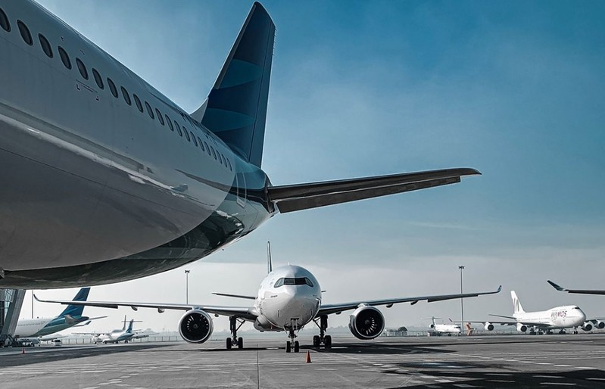

Employement laws
Effective compliance with the employment laws can help IndiGo Airlines in strengthening its employer brand image, which is important for attracting and retaining the top talent from the market amid the ongoing war for talent.

Slide 15
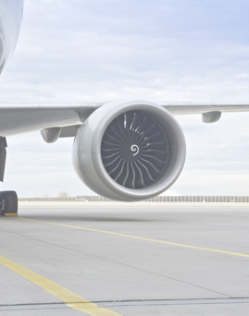
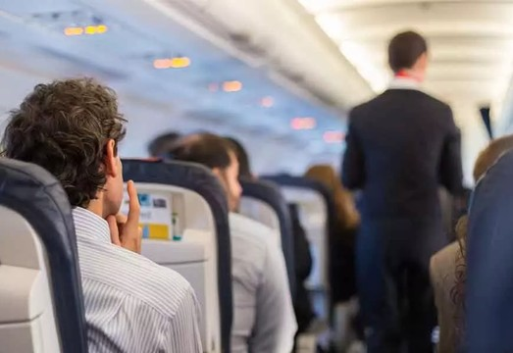
Micro environment factors
that imapact the overall business environment
SWOT Analysis
Strenght Weekness Opportunities Threat

Slide 16

Strenghts
Positive image
IndiGo Airlines works effectively providing high-quality service with low travelling costs. People choose IndiGo Airlines for the service, cost and constant offers provided by IndiGo Airlines.
Corporate social responsibility
IndiGo Airlines not just focuses on business but also participates in social activities through IndiGo Airlines reach, which will benefit the society and the rural areas in upliftment, child education, women empowerment and environmental activities.
High stakeholder engagement
IndiGo Airlines has a high employee satisfaction rate and it is very transparent to its customers and provides accurate information.They communicate often with their customers and work on customer feedback and the satisfaction of customers.

Slide 17

Weekness
Sustained Profit
IndiGo Airlines has been termed as a low-cost carrier, as a result, it has to lower the
cost of travelling. Due to this reason IndiGo Airlines was unable to generate and sustain profits consistently.
Over dependence on volume
In order to sustain the profits of the company, they should ensure that volumes are
high and the business cannot be affected by fluctuations of the demand. The company has to invest more and take measures to manage even during unexpected situations like pandemics, where business goes low.

Slide 18
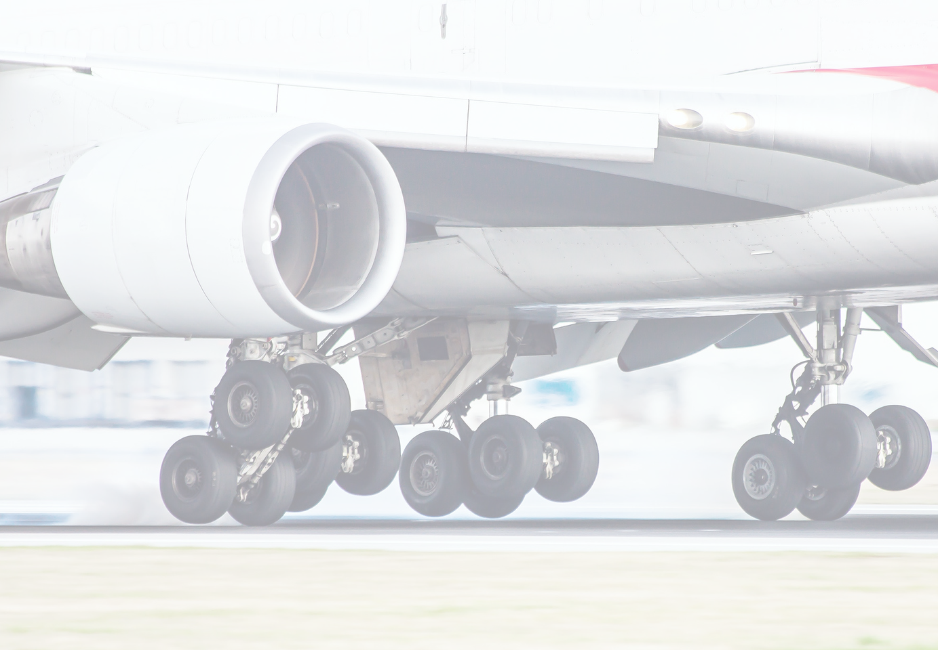
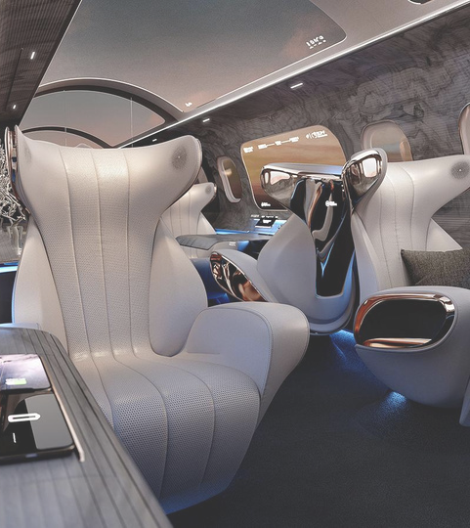
Opportunities
Globalisation
Since there is demand for travel to foreign countries. IndiGo Airlines has a growing opportunity and it
increases the network as there is international travel.
Increase in demand
The business can make use of the chance by establishing various interactive digital platforms for marketing IndiGo Airlines business and gaining maximum customers.
Growing demand for foreign trade
In today’s generation we have seen people travelling to various foreign countries either for business, education or for holiday. So the demand for foreign travel is huge.

Slide 19

Threats
Competitors
IndiGo Airlines have a series of competition in domestic and worldwide competitors who alter according to the customer’s choice and preferences. This might affect the business of IndiGo Airlines.
Cost
The main expense of the aeroplane is the cost of fuel. The prices keep fluctuating every day, and IndiGo Airlines
charges low prices for travelling, managing these expenses is a serious threat.

Slide 20


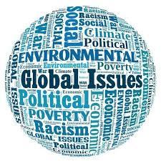
Strategic Situation
Global Challenges
Technological Progress
Extreme weather events might damage critical infrastructures and disrupt communications. The rapid urbanization and mobility of people will increase the risk from infectious disease. Due to this strategic relevance, large public transport hubs like railway station, airports and ports are considered a major potential target for terrorists.
Automation, robotics and AI are advancing quickly, transforming and working environment and changing the nature of work and the skills that employs need for doing their jobs. The future workforce will spend more time on activities of control, supervision, managing of people and communication.

Slide 21


Cyber security
Environment protection
Parallel to the or going digitalization within the air transport industry, there is growing awareness and concern about threats from cyber security. As system and planes become increasingly automated, the risk and potential impact of a cyber attack will continue to grow.
For the past decades, the airlines industry has been largely considered as a significant contributor to global carbon emission. As reported in the flightpath 2050 the environmental challenges and the use of renewable resources will be a key driver for the aviation sector.

Slide 22

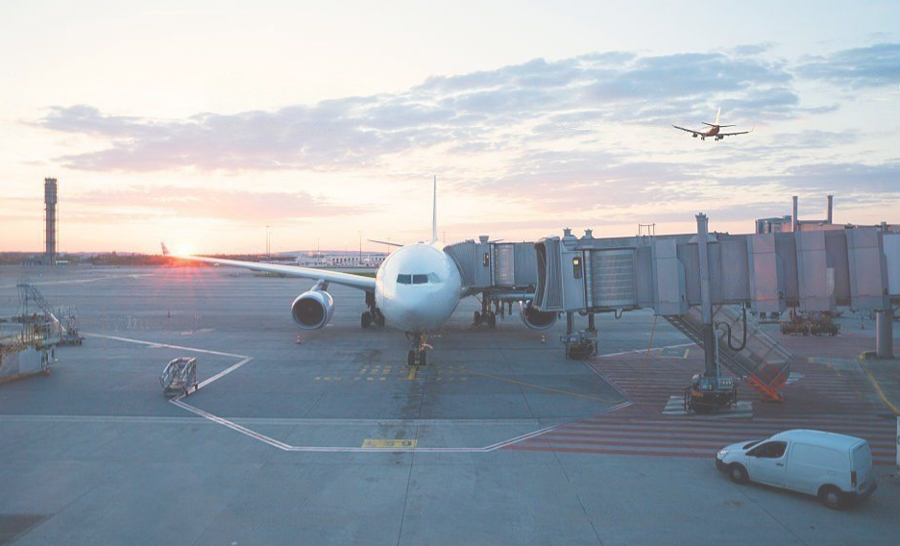
Consumers
Customer experience is always at the top of the priority list for airlines. Customers that are dissatisfied or disengaged inevitably result in fewer passengers and less money. It is critical that clients have a positive experience every time they travel.
Suppliers
IndiGo has been forced to ground 20 of its 276 planes due delays in the supply of spare engines by manufacturer Pratt & Whitney. This has delayed induction of new aircraft too.

Slide 23
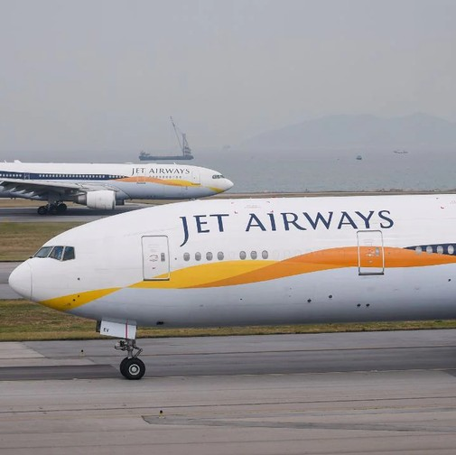

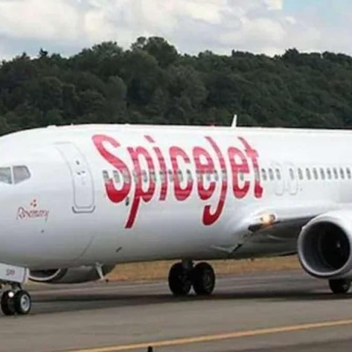
Competitors
Jet Airways
Air India
Spicejet

Slide 24
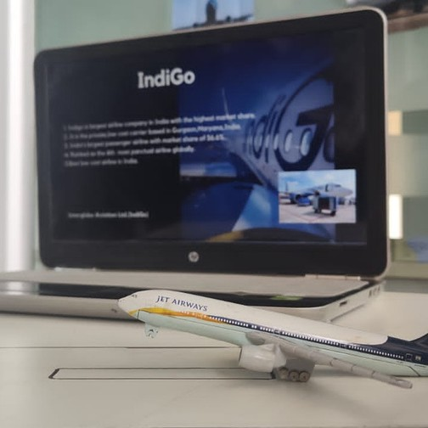
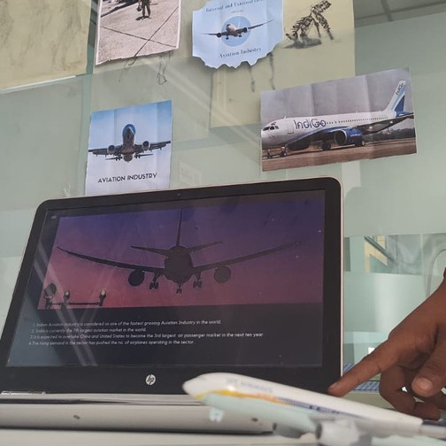
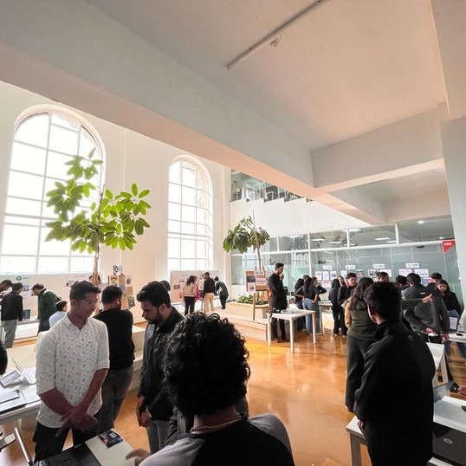
Some Insights of the exhibition-

Slide 25
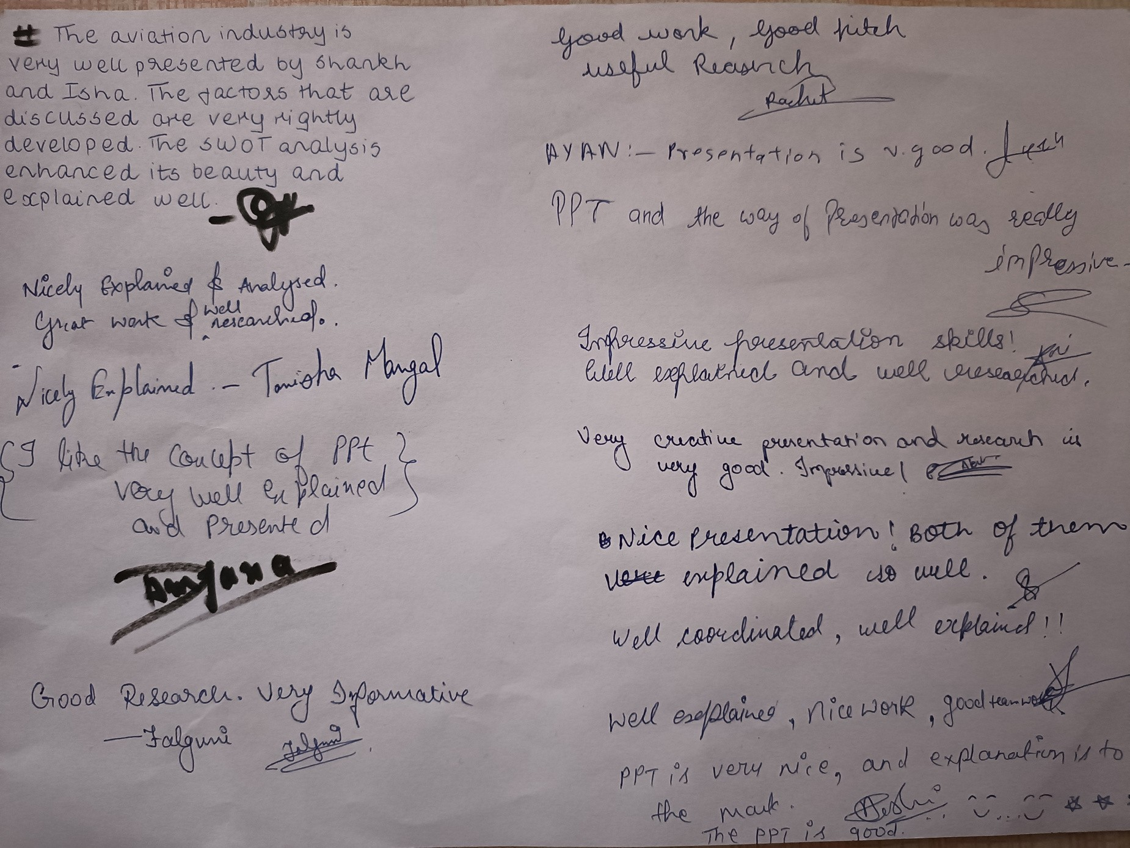
Feedbacks

Slide 26

Learning Outcomes-
Gained knowledge about Aviation Industry. Came to know about the various factors.
Enhanced presentation skills.
How business environment seems to be in real life.

Slide 27
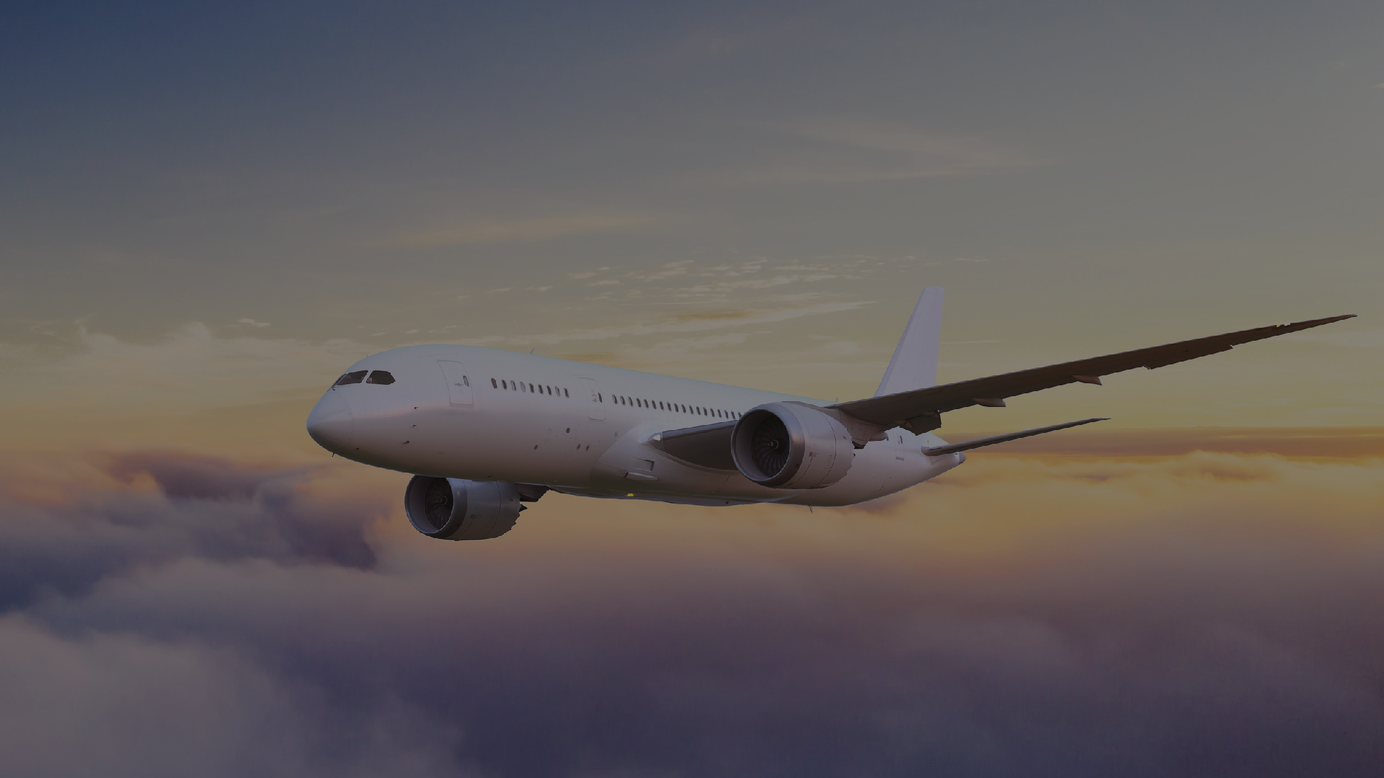
Thank You

